Slide 1
Gene Expression Patterns in Drosophila Embryos using lacZ Transgenes
June 18th
ABLE 2014
University of Oregon, Eugene
Cathy Silver Key
Julie Gates
Jessica Sawyer
Kirsten Guss

Slide 2
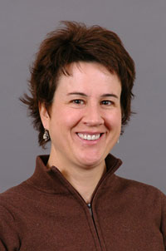
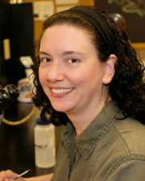
Acknowledgements
Funding from Roberta Williams Teaching Initiative Grant through the Association for Biology Laboratory Education to SCSK.
Cathy Silver Key,
co-author,
North Carolina Central University
Julie Gates,
co-author,
Bucknell University
Jessica Sawyer,
co-author
Duke University
Kirsten Guss,
Co-author
Dickinson College

Slide 3
Outline
Part 1 presentation: Brief introduction to lab and protocol
Perform protocol
Part 2 presentation: Return to presentation while embryos staining
Why gene expression patterns matter
Strains: balancer and genetics
Typical Results
Student data
Observe embryos

Slide 4
Part I: Introduction to lab and protocol

Slide 5
Target and Timing
Target audience: Genetics (2nd semester sophomore) or Developmental Biology (juniors/seniors)
Timing: Two 2 hour lab sessions (plus 1 page paper)

Slide 6
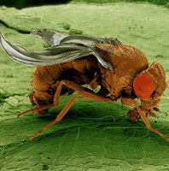
How do genes shape animals?
Photo credits:
Eye of Science/Science Photo Library
Parkhurst Lab

Slide 7
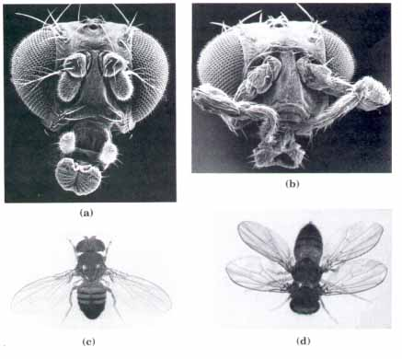
How to avoid developmental defects?

Slide 8
How did scientists begin to understand how genes controlled shape/pattern?
Forward genetic screen
Randomly mutagenize flies
Clone mutants
Characterize gene expression patterns

Slide 9
How do we know when these Genes are Expressed/’Turned on’?

Slide 10
REPORTER GENE
a piece of DNA that codes for an easily observed product:
Green Fluorescence Protein
Beta-galactosidase

Slide 11
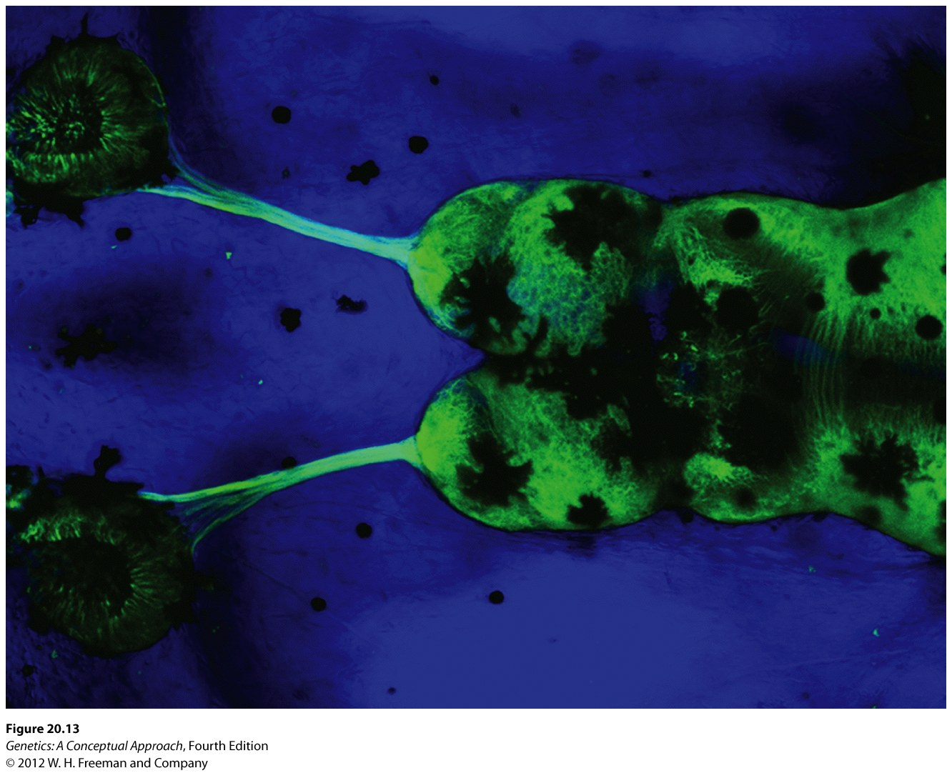
Tadpole Brain: Expression of GFP under the control of β-tubulin gene expression regulation
β-tubulin regulatory DNA sequences
GFP
GFP mRNA
GFP
Green Fluorescent Protein expressed where-ever b-tubulin would be expressed
Notes:
The panel on the left shows tadpole brain
GFP is a gene from a different species: jelly fish
So, it is not only an example of a reporter gene, but also an example of a transgene…

Slide 12
lacZ Reporter in Fly embryo
wingless gene regulatory DNA sequences
lacZ sequence
Tissue specific expression
lacZ mRNA
ß-galactosidase enzyme
X-gal
substrate
Notes:
LacZ protein is called β-galactosidase enzyme (BLUE) that is normally expressed only in bacteria, but here it is under the control of a Drosophila regulatory DNA and is expressed where ever the Drosophila wingless gene would normally be expressed in the Drosophila embryo
In the experiment you will be doing, you will be using the lacZ reporter gene/sequence. This gene encodes the beta-galactosidase enzyme which can be detected as a blue color in different embryo tissues. Shown in this example, the lacZ gene is under the control of the wingless gene regulatory sequences: transcription of the lacZ gene can only occur in tissues where the wingless control regions would ‘turn on’ expression of the wingless gene. We have just replaced the wingless coding region with the lacZ coding region so we can see it. Where ever we see blue staining, this means that the colorless wingless gene product would normally be expressed in these cells at this time during embryo development.

Slide 13
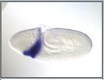
Different Drosophila regulatory sequences can turn on the bacterial lacZ reporter
even-skipped gene regulatory DNA sequences
lacZ sequence
Hunchback gene regulatory DNA sequences
Deformed gene regulatory DNA sequences
lacZ sequence
lacZ sequence
lacZ mRNA
lacZ mRNA
lacZ mRNA
β-gal
β-gal
β-gal
Notes:
Each gene is turned on in a subset of all the embryo’s cells.
For example,
Hunchback (example of a gap gene) is turned on in a really big solid region near the anterior or head of the embryo and a wide stripe near the posterior of the embryo.
Even-skipped (example of segmentation gene) is turned on in stripes
Deformed (example of homeotic gene) is turned on near the anterior (head) region, but in one wide stripe.

Slide 14
How did the Bacterial lacZ gene Sequence Get into the Drosophila Genome?

Slide 15
Transgene
A transgene is defined as a gene that is taken from one species and is inserted into the genome of a different species.
In our lab the gene being taken = lacZ from bacteria
And ‘different species’ genome = Drosophila

Slide 16
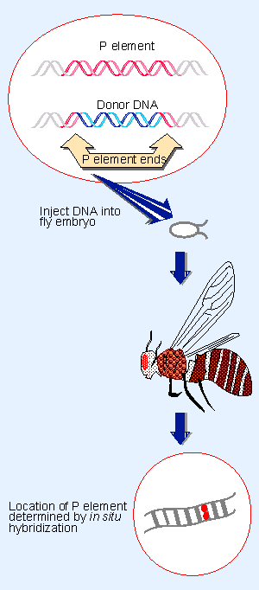
Making a Transgenic Fly
P element = transposable element
Which can insert into the fly genome
The P element genes in the middle are removed
And replaced by Donor DNA
Donor DNA =
Drosophila Gene Regulatory Sequences(DGRS)
P element lacZ reporter in every cell of the fly!
lacZ sequence
Notes:
The Drosophila Gene Regulatory Sequences (DGRS) are from Drosophila genes like Kruppel, Hunchback, even-skipped, wingless, Deformed, and abdominal A.
The reporter lacZ DNA on the P –element is injected into a fly embryo. The DNA will incorporate into the

Slide 17
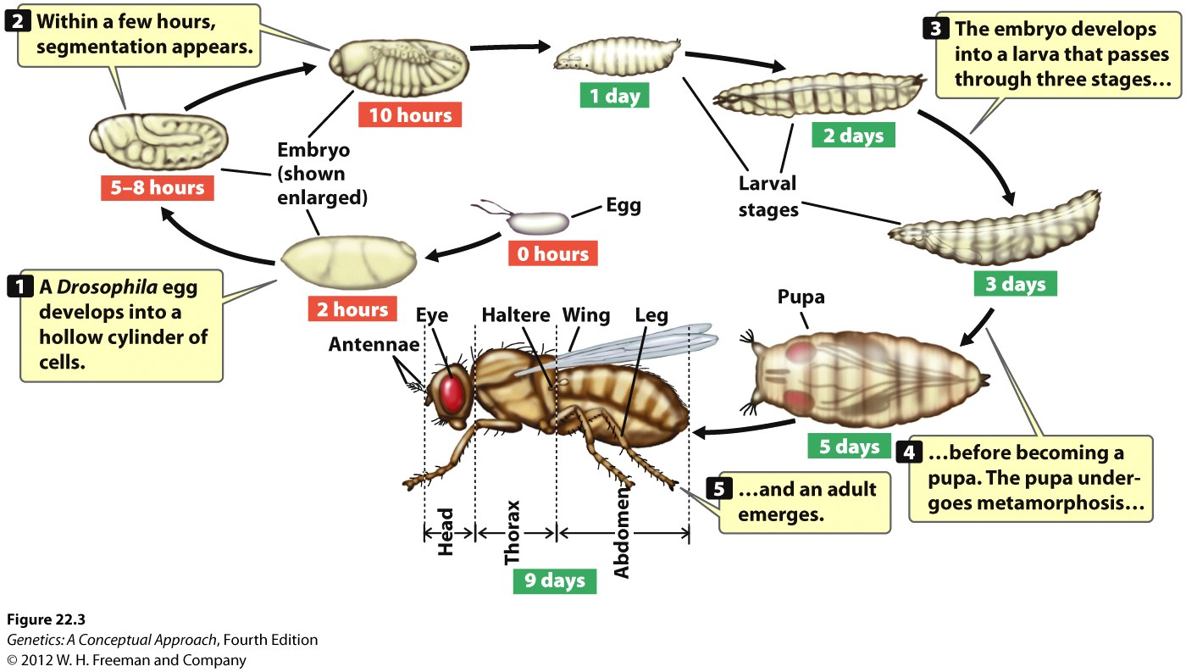
Drosophila Life Cycle
Notes:
In this diagram is shown the life cycle of Drosophila melanogaster, commonly known as the fruit fly.
The egg contains an embryo that will quickly develop.
Importantly, the segments that determine the body parts of the adult fly are set up by the end of embryogenesis ( see the 5-8 hr and 10 hour old embryos).
The larva hatch from the egg and eat and eat and eat – they are voracious eaters. The grow large and finally form a pupal case to allow metamorphasis to occur from the larval form to an adult fly form. This is similar to butterfly metamorphosis.

Slide 18
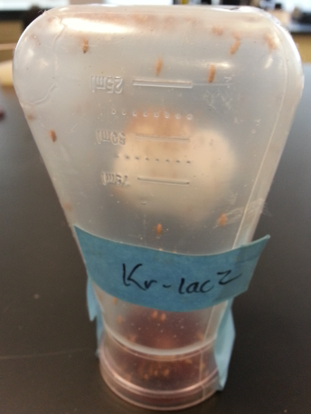
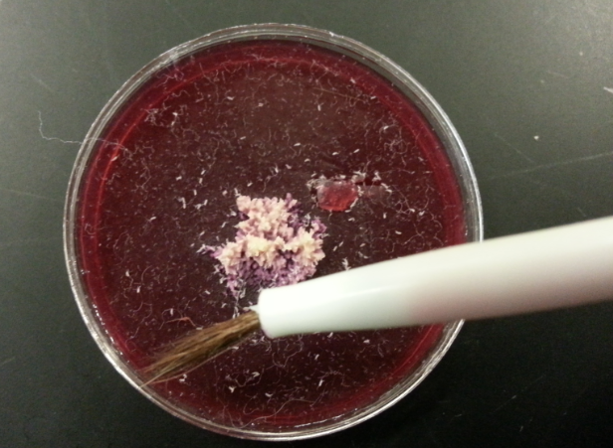
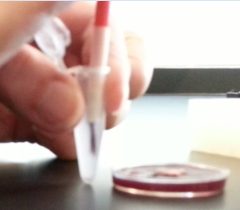
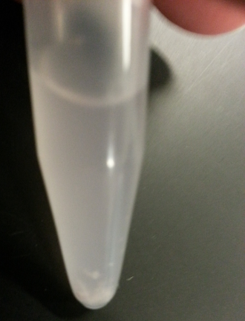
Drosophila enhancer-lacZ Protocol
Follow protocol:
Remove water
Bleach off chorion
Wash off bleach
Fix with formaldehyde (nutate)
Wash off formaldehyde
Add staining solution and X-gal 37 degrees
Once stained, wash off X-gal
View under stereoscope using depression slide
If time permits, mount in 70% glycerol

Slide 19
Summary of Drosophila regulation of lacZ Gene Expression Lab
Your group will be given an ‘unknown’ embryo-containing eggs that were laid by different transgenic flies.
Numbered 1,2,3,4,5,6 or 7.
Aim: determine which Drosophila gene regulator is turning on the bacterial lacZ reporter in your transgenic embryos.

Slide 20
Start Lab protocol

Slide 21
Part 2: Why Gene Expression Patterns Matters, Typical Results & Student Data

Slide 22
How does gene expression shape a fly?

Slide 23
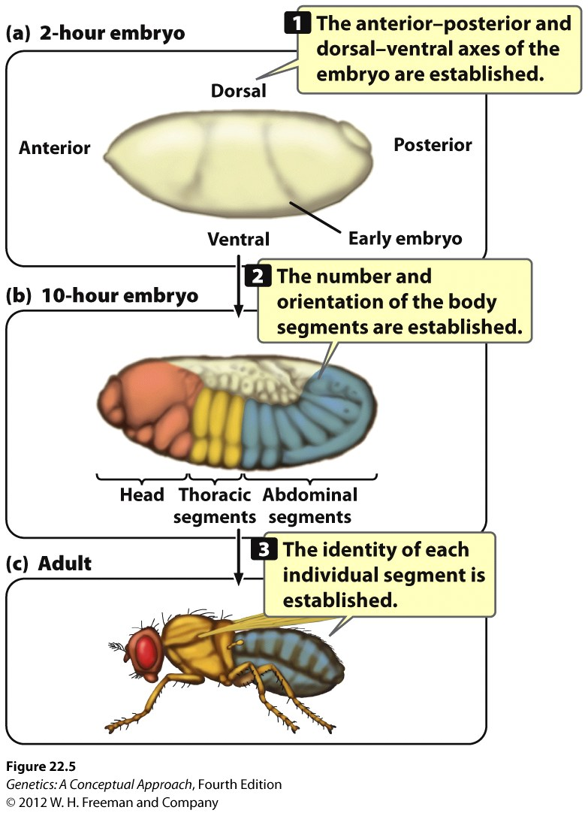

Slide 24
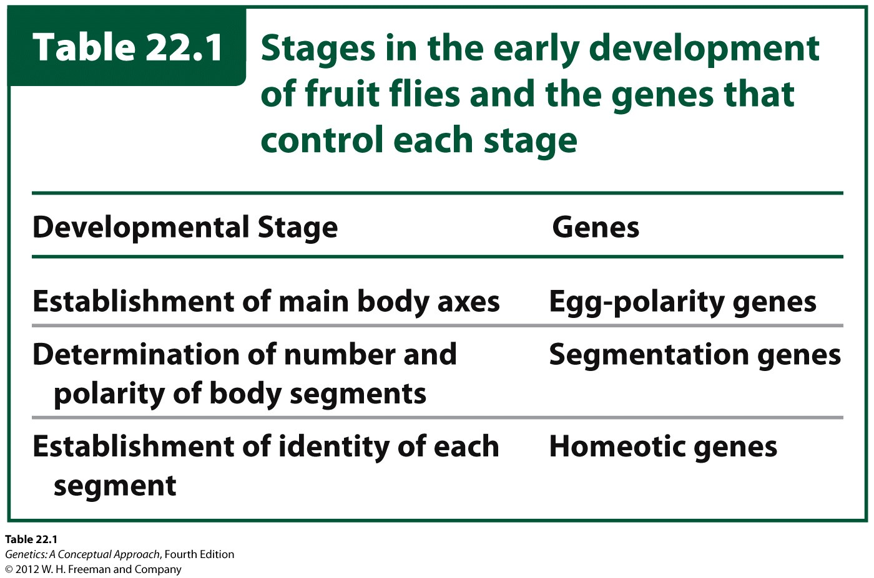
Notes:
Tabel 22.1 indicates three types of genes needed for proper fly development:
The egg-polarity genes are needed to set up the main body axes:
1. anterior-posterior (or head and tail-end)
2. dorsal- ventral (back and belly)
3. right- left axis
The Segmentation genes are needed to separate the embryo into segments/parts. These parts will eventually develop into a perfectly developed adult fly complete with head, thorax, abdomen, tail end,…. All in the right order.
The Homeotic Genes establish the identidy of each segment – making sure the antennae are on the head and the legs/wings are at the thorax.

Slide 25
Cascade of Gene Regulation
1. Egg Polarity Genes
Gap Genes
Pair-rule genes
2. Segmentation Genes
Segment-polarity
genes
3. Homeotic genes

Slide 26
Drosophila Enhancers in this lab: Gene Expression Correlated to Embryonic Stage
Maternal gene expression pattern
Stages 0-1 eg. Hunchback gene expression
Gap gene expression pattern
Stages 4-6 eg. Hunchback & Krüppel gene expression
Pair-Rule gene expression pattern
Stages 4-8 eg. fushi tarazu, even-skipped gene expression
Segment Polarity gene expression pattern
Stages 5-11 eg . wingless gene expression
Note: stages 8-11 germ band (from posterior) is elongating (see Appendix A for pictures)
Homeotic gene expression pattern
Stages 4-8 eg. Dfd (gap early stages, anterior later stages), AbdA & Ubx (gap earlier stages, mid to posterior in germband retraction through stage 12)

Slide 27
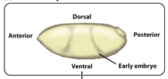
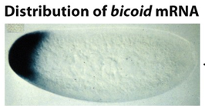
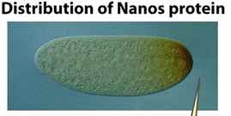
EGG POLARITY GENES: Define Major BODY AXES
Head
Tail-end

Slide 28
Example Expression Pattern
A
P

Slide 29
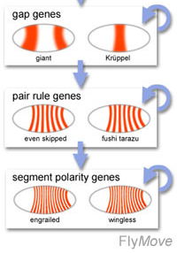
3 Different Types of Segmentation Genes
Some of our mystery genes!
Notes:
This slide shows the 3 types of segmentation genes:
Gap genes
Pair-rule genes
Segment-polarity genes
The diagram shows an example of each type of gene.
Kruppel is a gap gene (like hunchback)
Even-skipped is an example of a pair-rule gene
And gooseberry is an example of a segment-polarity gene.
Notice that phenotypes are shown when each type of gene is mutated? What happens to the size of the larva in each case? What’s missing? Some thorax? Some abdomen? For example, a homozygous mutation in the Kruppel gene results in a very small larva that has not thorax! And very little abdomen.

Slide 30
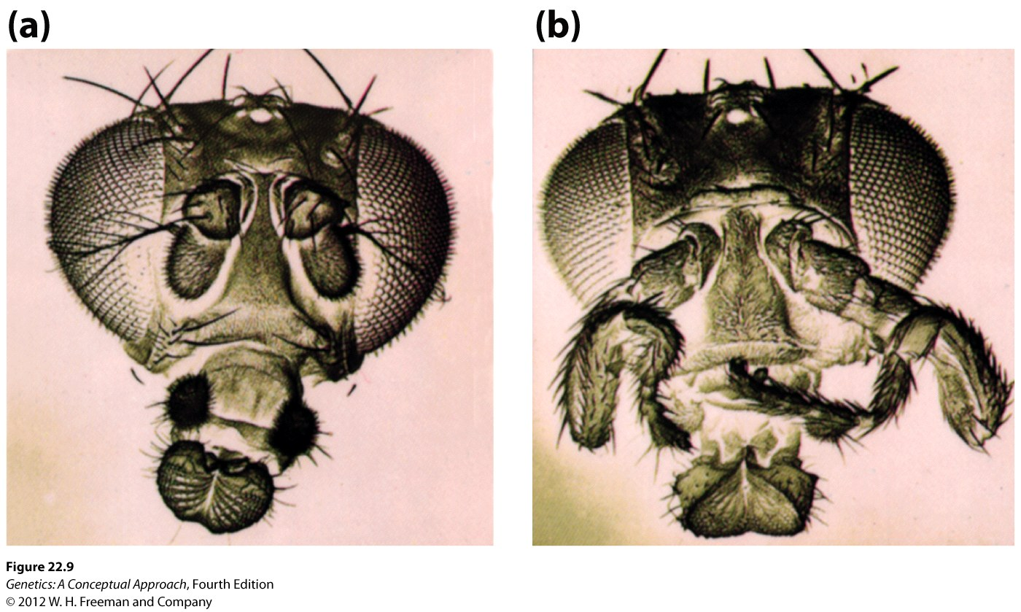
Homeotic Genes needed to make sure parts like legs are formed in the thorax and NOT on the head (left/(b))
Notes:
The mutant homeotic gene here is called Antennapedia.

Slide 31
Homeotic Genes are found in two regions of the Drosophila chromosome:
1. Antennapedia complex 2. Bithorax complex
Deformed (Dfd) and abdominal A (abdA) genes are two of our mystery genes!

Slide 32
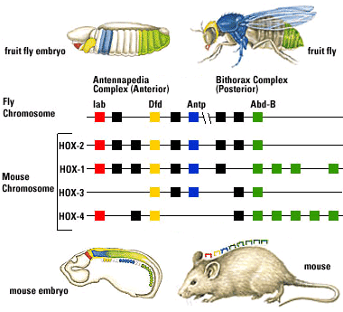
Homeotic Genes Conserved in Mammals

Slide 33
Possible Genes Regulators that turn on lacZ Reporter Gene
abdominal A (Abd A)
Deformed (Dfd)
even-skipped (Eve)
fushi tarazu (ftz)
hunchback (hb)
Krüppel (Kr)
wingless (wg)

Slide 34
25% Embryos lack enhancer-lacZ gene: wingless (wg)-lacZ example
wg-lacZ
wg-lacZ
Parents:
x
CyO balancer
CyO balancer
+
TM3, ftz-lacZ
F1 Embryos:
wg-lacZ
wg-lacZ
+
wg-lacZ
CyO balancer
wg-lacZ
CyO balancer
TM3, ftz-lacZ
CyO balancer
CyO balancer
= death during embryogenesis, because CyO balancer carries a mutation that is lethal when it’s homozygous.
Notes:
CyO balancer is an inverted (shuffled) chromosome so that it cannot recombination with the recombinant chromosome (containing the enhancer-lacZ construct) cannot occur. Recombination could result in the loss of the enhancer-lacZ construct over many fly generations.

Slide 35
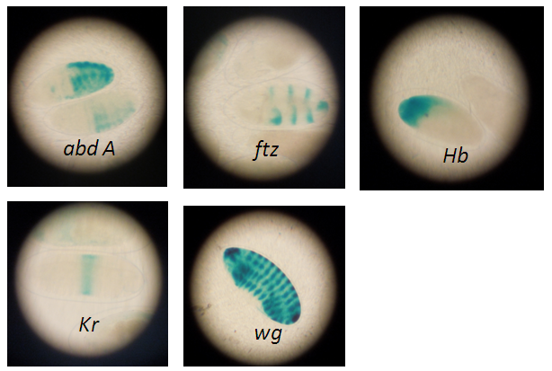
Typical Results at NCCU Spring 2014
Notes:
Embryos were mounted in 70 % glycerol and observed using student compound microscopes with 10x objective. A digital camera was used to capture images for student lab reports.

Slide 36
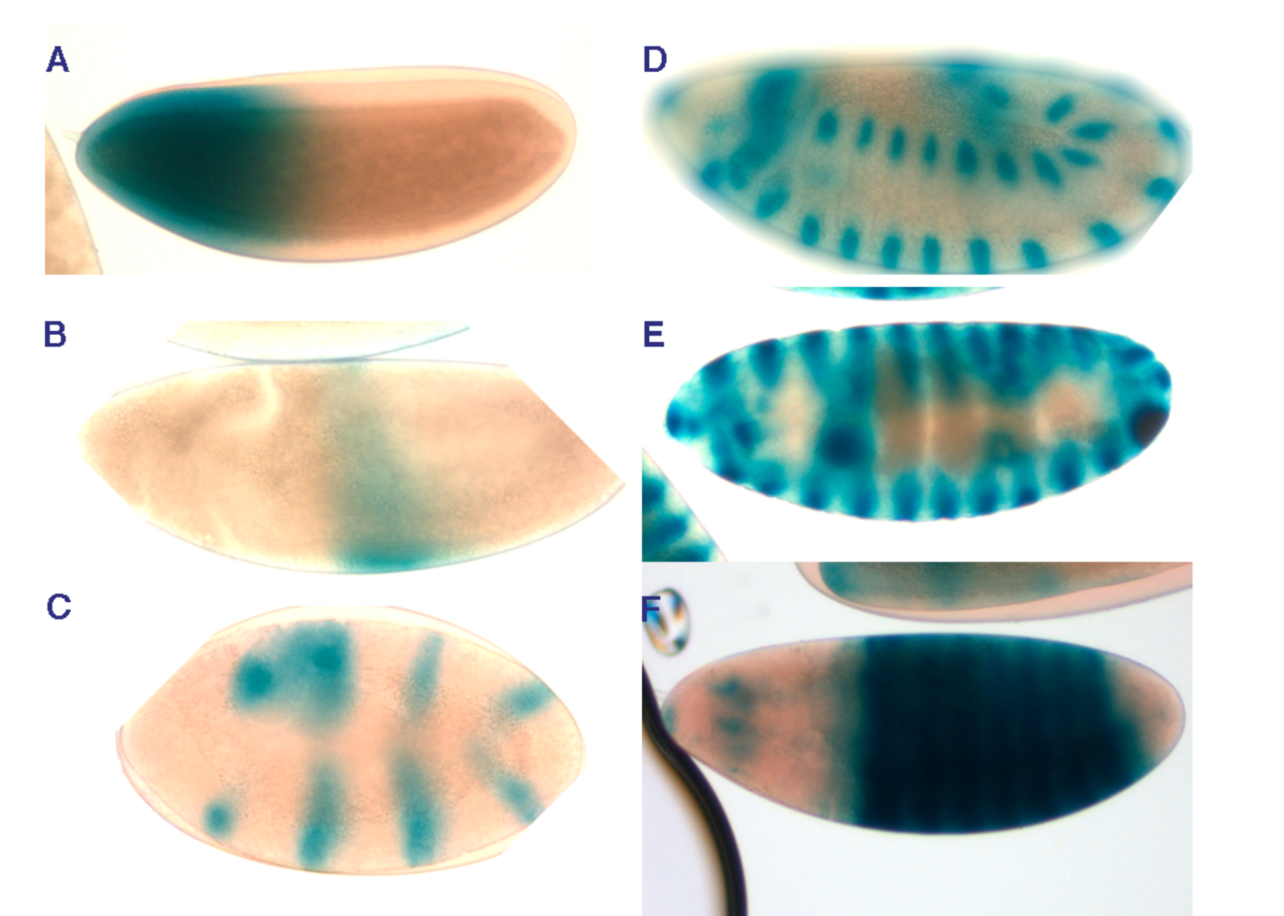
Typical Results at Dickinson College, Carlisle, PA
Notes:
Typical student data generated using this protocol.
Images were collected using a Nikon E800 compound microscope equipped for differential interference contrast illumination. Images were cropped and adjusted for brightness, contrast, and levels using Adobe Photoshop. All embryos are oriented anterior to the left, and were staged according to Hartenstein, 1993. A, BDSC#76 (hb-lacZ) shows intense staining in the anterior end of a stage 5 embryo. B, BDSC#10392 (Kr-lacZ) shows a stripe of expression about mid-length of a stage 6 embryo. C, BDSC#335 (eve-lacZ) shows seven stripes of expression in a germ band extended (approximately stage 10) embryo. D, E, BDSC#1672 (wg-lacZ) shows stripes of expression along the length of stage 12 (D) and stage 15 (E) embryos. F, BDSC#9120 (Ubx-lacZ) shows expression a subset of thoracic and abdominal segments.

Slide 37
Notes:
Students did make knowledge-based learning gains.

Slide 38
Notes:
Student Post-Survey for Enhancer-lacZ Embryo Gene Expression Patterns Lab. Spring 2014 BIOL3100 (Genetics) North Carolina Central University students were asked to respond to statements after participating in the lab on whether the agreed with each statement on a scale of 1-5 with 1=strongly disagree and 5=strongly agree. In this one semester run, surveying 36 students after participating in the lab activity, the results suggest that student confidence in understanding the concept of gene expression in eukaryotes has significantly increase (p= 0.00015 when comparing responses to statements 10 and 11). Students also responded in agreement to statements that the lab was 1.collaborative (4.2±0.9), 2.interesting & engaging (4.0±1), 3. Enough time to complete lab (3.9±1), 4. Easy protocol (4.2±1), and 5. Better understanding of gene expression concept (3.6±0.9). Notably, students were either neutral or disagreed with the statement that the lecture alone would suffice in understanding the concept of gene regulation (2.75±1).

Slide 39
Example Student Responses, Bucknell University: Q#1What do you think is beneficial about learning using this particular activity? Spring 2013
It's hands-on and gave us the opportunity to apply lecture to lab to better understand the material.
I think any hands on lab work is beneficial overall in better understanding what is happening and what has been discussed in lecture. I found it to be helpful in comparing different gene expressions.
Getting a visual representation of gene patterning and seeing how they look in 3D embryos, not just textbook drawings.
You were able to visualize where the different genes were expressed.
It is a hands on activity plus you get to see exactly how things you learn about in lecture really work.
Use of tangible experiment to see what we lecture about in class.

Slide 40
Example Student Responses, Bucknell University: Q#2: What did you learn from using this activity?
The expression of different genes at different stages as well as how to visualize and use the technique of a reporter gene, specifically lacZ.
I got a better understanding of how these genes were really expressed and was able to compare them easily too.
More about Drosophila development; reporter genes and A/P patterning.
Identifying embryo stages, staining procedure, applying patterning material from class to determine the type.
Not much in addition from lecture. It just clarified the concepts. How to use a reporter gene in lab.
I learned how Drosophila start to develop and what actions they must go through.
Different stages of embryonic development. Different patterns of expression.
I learned the different phases of development much more thoroughly (specifically the different cell types and their movements as development progressed).

Slide 42
Notes:
N=8

Slide 43
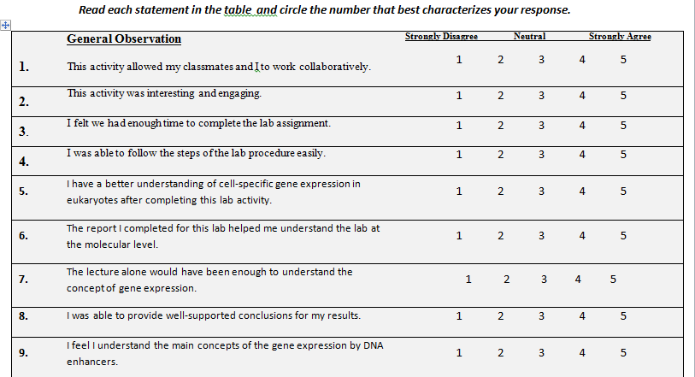
Post-Survey Evaluation Tool

Slide 44
Example Pre-/Post Quiz Questions

