Slide 1
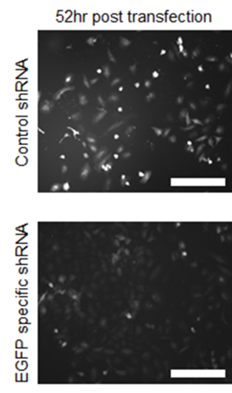
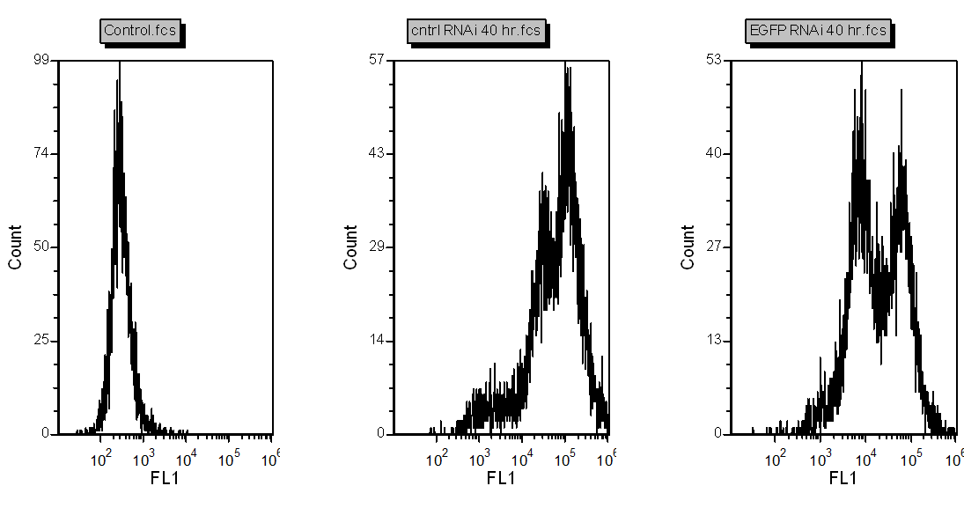
A.
B.
A. Fluorescence microscopy of transfected HeLa cells using control or EGFP-specific shRNA co-expressed in pEGFP-C3 vector 52 hours post transfection. Scale bar is 200 μm. B. As A but now a flow cytometric analysis of EGFP fluorescence (FL1 on x-axis) at 40 hours post transfection. The control on the left is non-transfected cells while the middle (control shRNA) and right (EGFP-specific shRNA) graphs are transfected with the constructs from A. The y-axis describes the number of cells (count) at a given fluorescence intensity on the x-axis. Note the reduction in fluorescence intensities both qualitatively (A) and quantitatively (shift of peaks in the graph to the left along the x-axis with EGPF-specific vs control shRNA; B).

