Slide 1
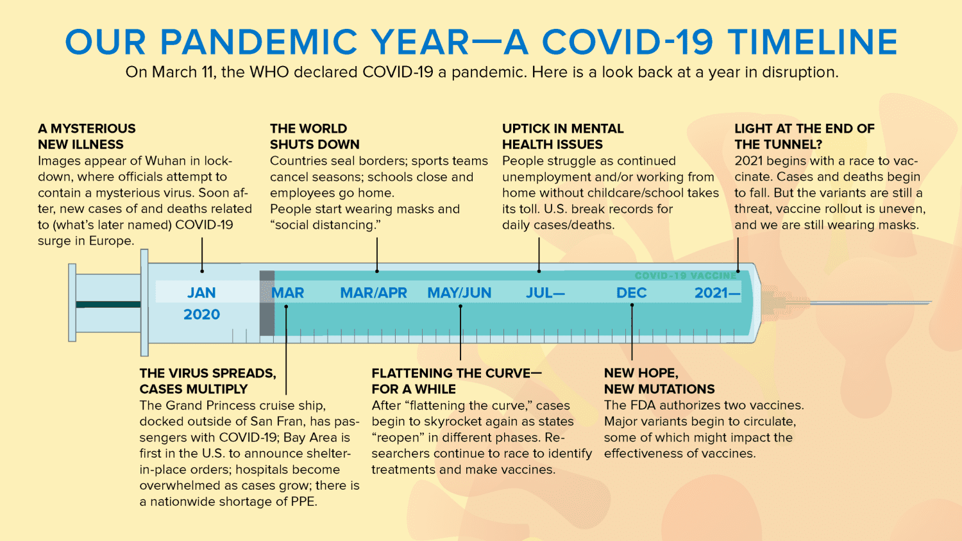
Mapping Mutations in the SARS-CoV-2 Genome
https://www.yalemedicine.org/news/covid-timeline

Slide 2
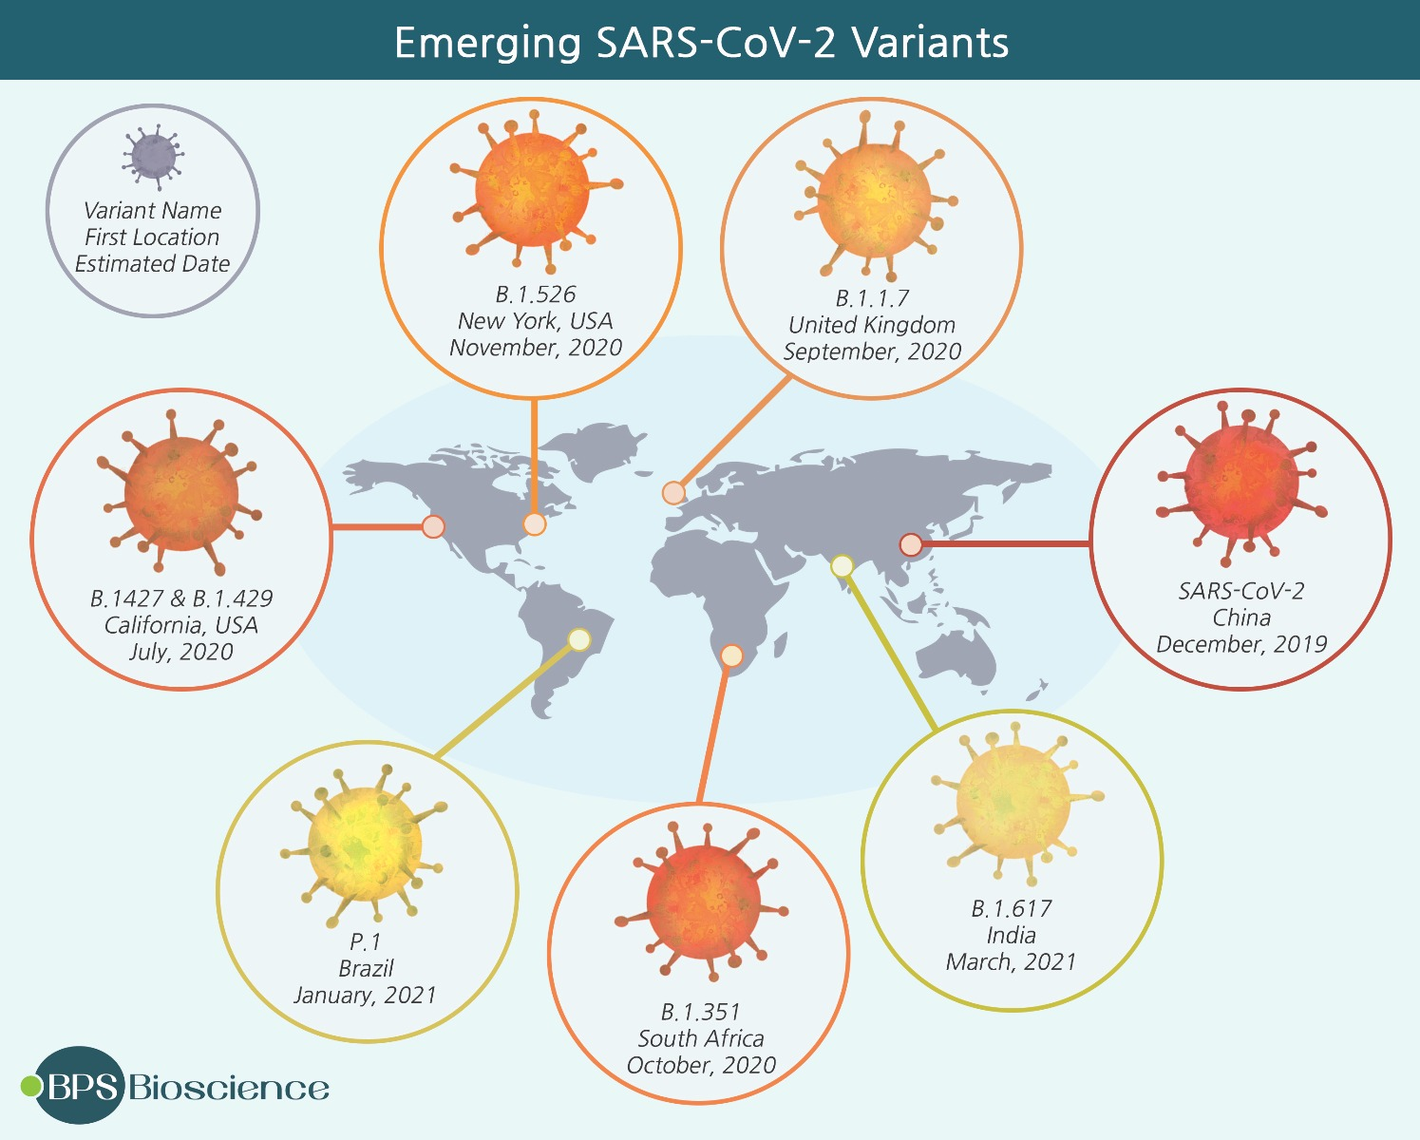
https://bpsbioscience.com/sars-cov-2-variants

Slide 3
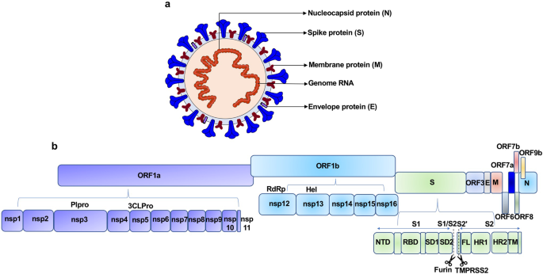
https://www.nature.com/articles/s41392-021-00653-w

Slide 4
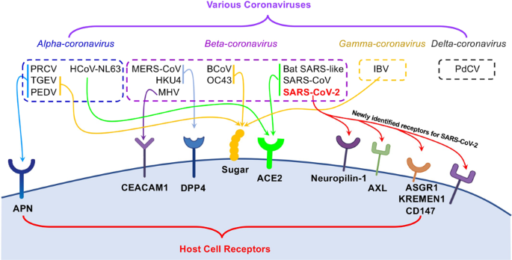
https://www.nature.com/articles/s41392-021-00653-w

Slide 5
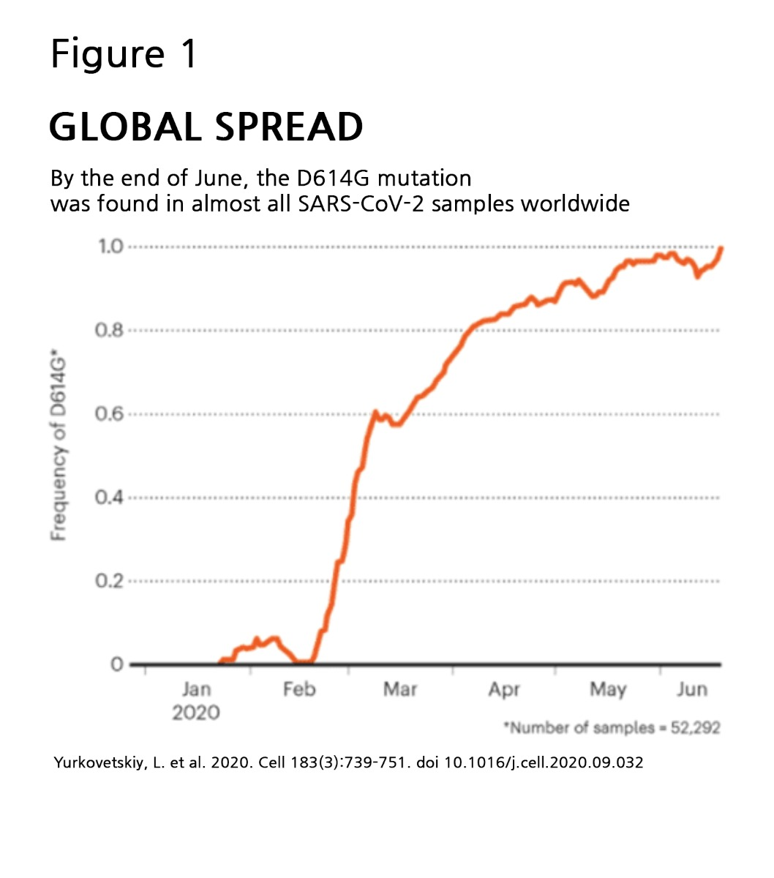
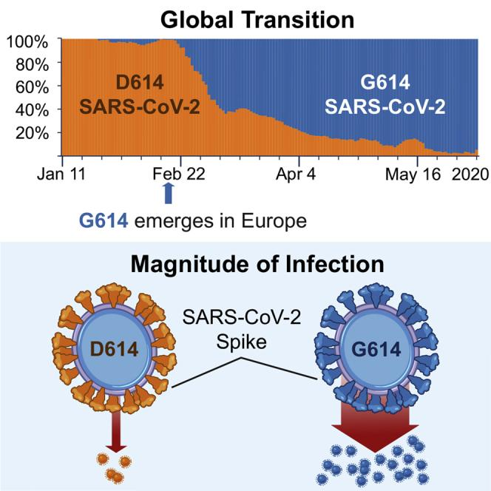
Early Variants
Spike D614 was the original Wuhan form
Associated with higher viral loads

Slide 6
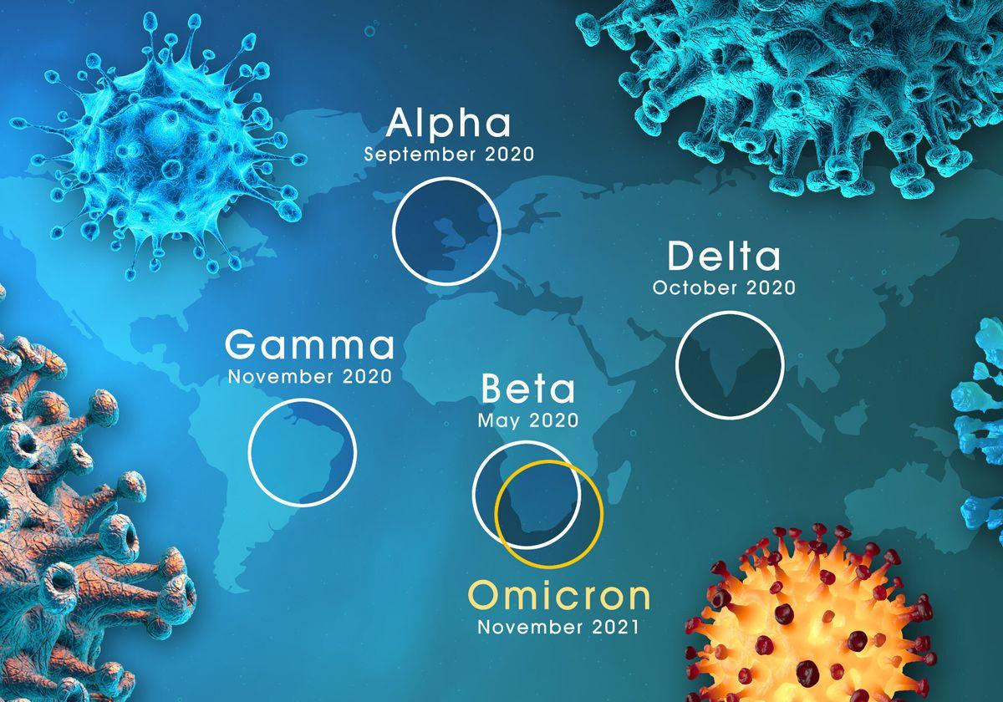
https://www.the-scientist.com/news-opinion/omicron-is-who-s-fifth-variant-of-concern-experts-urge-patience-69472

Slide 7
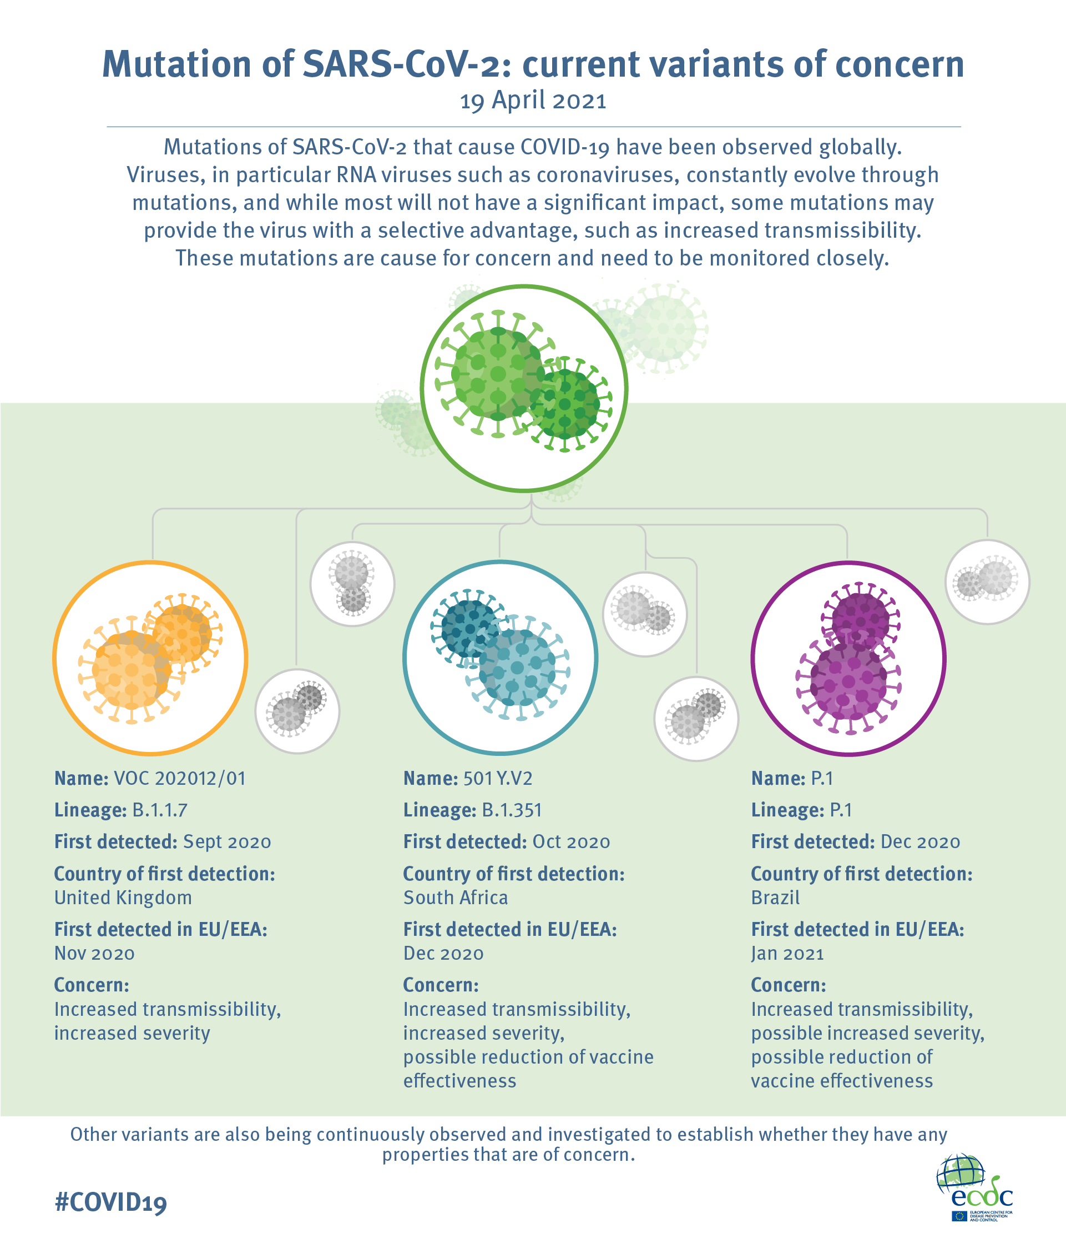
Later Variants
Alpha – B.1.1.7
  30-50% more contagious
Beta – B.1.351
Gamma – P.1
Delta - B.1.617.2
  50% more contagious
  Infectious longer
https://www.ecdc.europa.eu/en/publications-data/covid-19-infographic-mutations-current-variants-concern

Slide 8
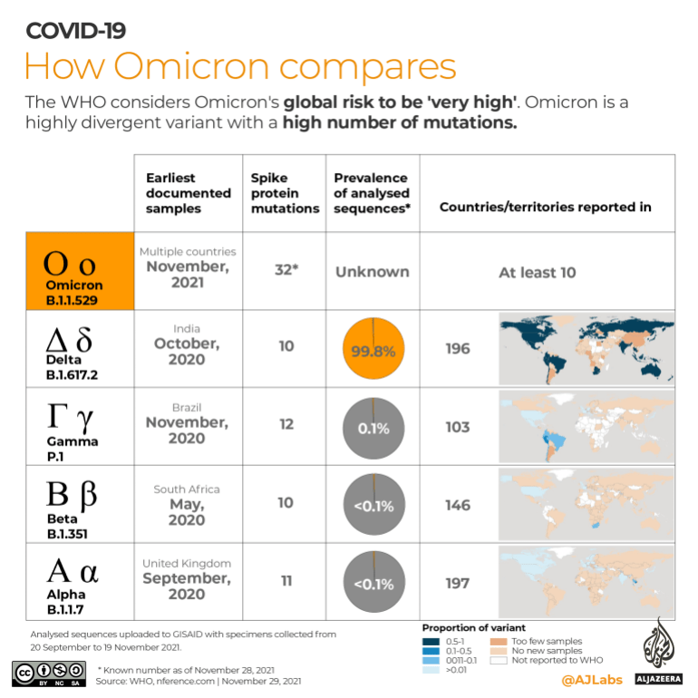
Omicron
3x (or more) better spread than delta variant
Evades immune system better
https://www.aljazeera.com/news/2021/11/29/infographic-how-omicron-compares-to-other-covid-variants

Slide 9
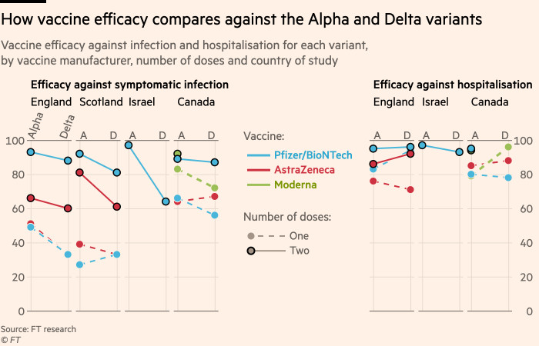
Consequences for prevention
https://www.ft.com/content/5a24d39a-a702-40d2-876d-b12a524dc9a5

Slide 10
Our Data
UPenn SARS-CoV-2 variant database
Mid-June 2020
International data - primarily South African data with some Chinese and European data

Slide 11
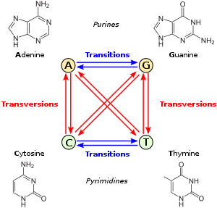
Transitions vs. Transversions
Transversions are more likely to cause changes in amino acid coded

Slide 12
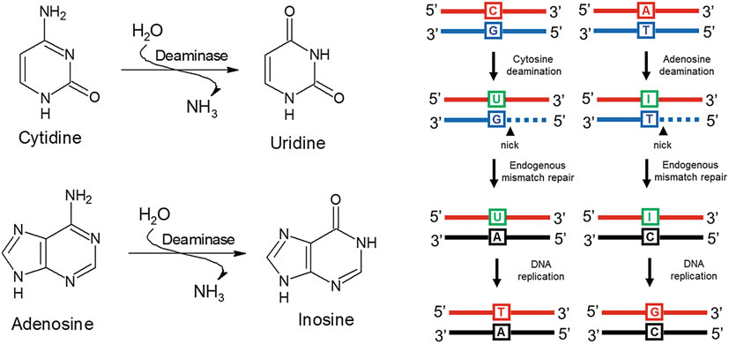
Most common mutations
C => T mutations are very common

Slide 13
Tracking Variants – Genomic Surveillance
https://www.cdc.gov/coronavirus/2019-ncov/variants/genomic-surveillance.html

Slide 14
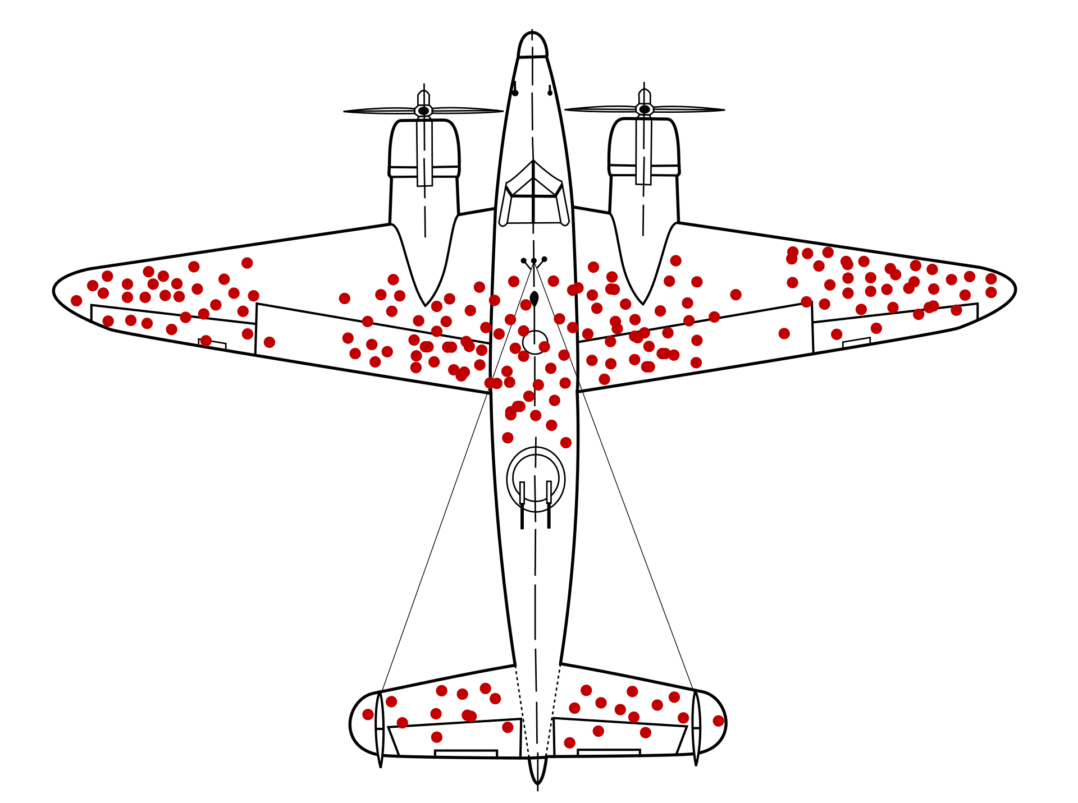
What types of variants can actually circulate in nature?
Which parts of the plane are essential?
Which parts of the plane are non-essential?
red dot = damage
https://en.wikipedia.org/wiki/Survivorship_bias#/media/File:Survivorship-bias.svg

