Slide 1
Using Dragonfly Larvae (Naiads) to Investigate Predator-Prey Interactions
Presenters and Collaborators:
William V. Glider, University of Nebraska-Lincoln: wglider1@unl.edu
Cristian Gonzalez: Will be attending Yale University this fall as Ph.D. candidate
Gage Kircher, University of Nebraska-Lincoln – recent grad & medical school applicant
Grace McManaman, University of Nebraska Medical Center – 3rd year medical student
Ethan Ramsey: Arizona State University Dept.- Microbiology- Ph.D. candidate

Slide 2
Predator-prey interactions
Predator–prey relationships are a central component of community dynamics.
“Recent approaches have begun to explore predator– prey relationships in
terms of an evolutionary ecological game in which predator and prey adapt
to each other through reciprocal interactions involving context-dependent
expression of functional traits that influence their biomechanics. Functional
traits are defined as any morphological, behavioral, or physiological trait of
an organism associated with a biotic interaction. Such traits include
predator and prey body size, predator and prey personality, predator hunting
mode, prey mobility, prey anti-predator behavior, and prey physiological stress.”
This lab uses dragonfly naiads to investigate their feeding efficiency on two prey species (daphnia and amphipods) under a variety of abiotic and biotic conditions.

Slide 3
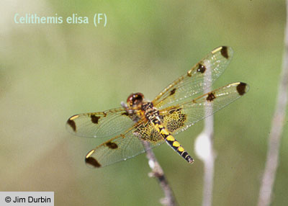
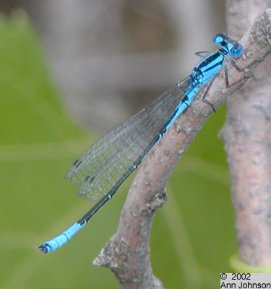
Classification of Dragonflies
Dragonflies are hemimetabolous insects (Phylum: Arthropoda; Class: Insecta; Order: Odonata; suborder Epiprocta). They are commonly found in shallow freshwater habitats world-wide. A second suborder includes the Damselflies.
Calico Pennant female
Azure Bluet male

Slide 4
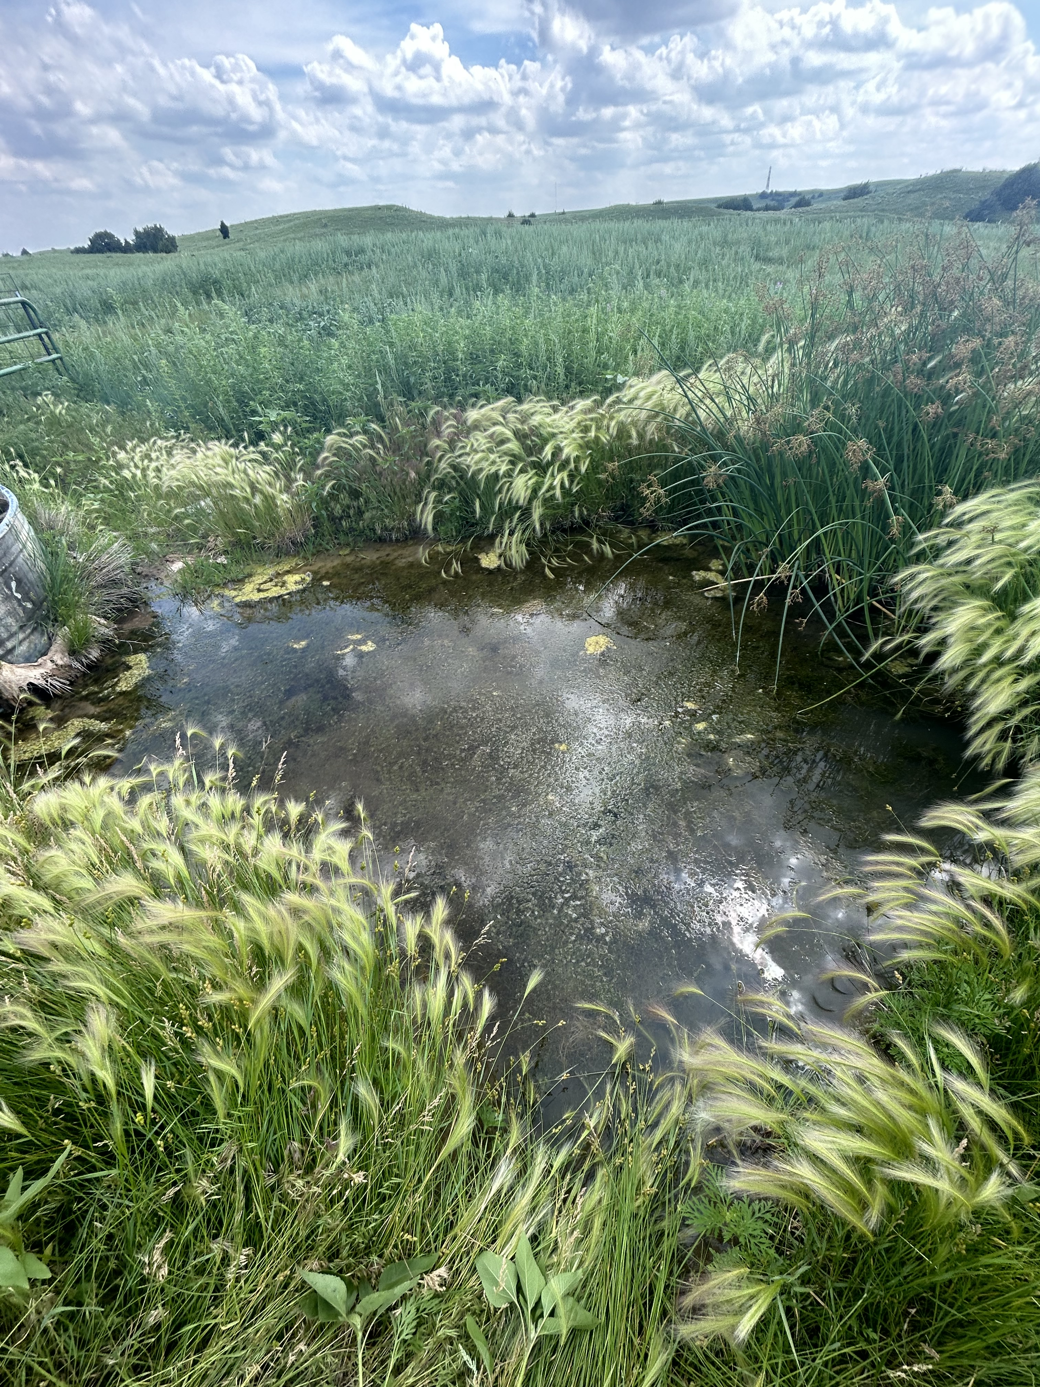
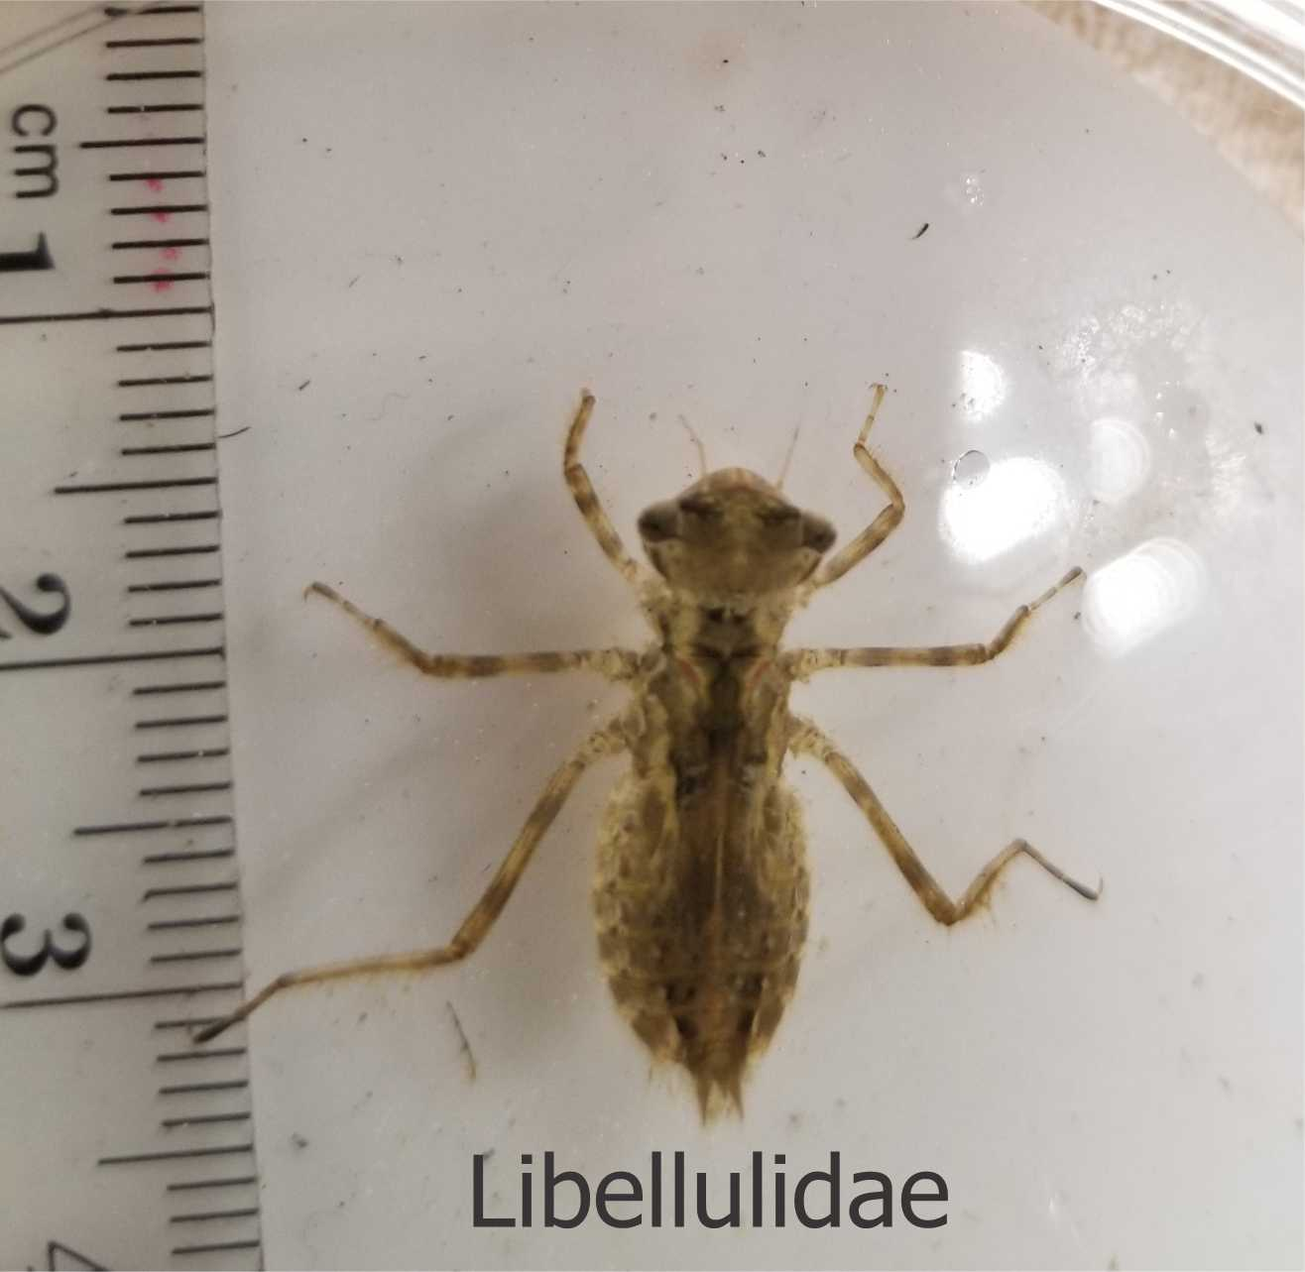
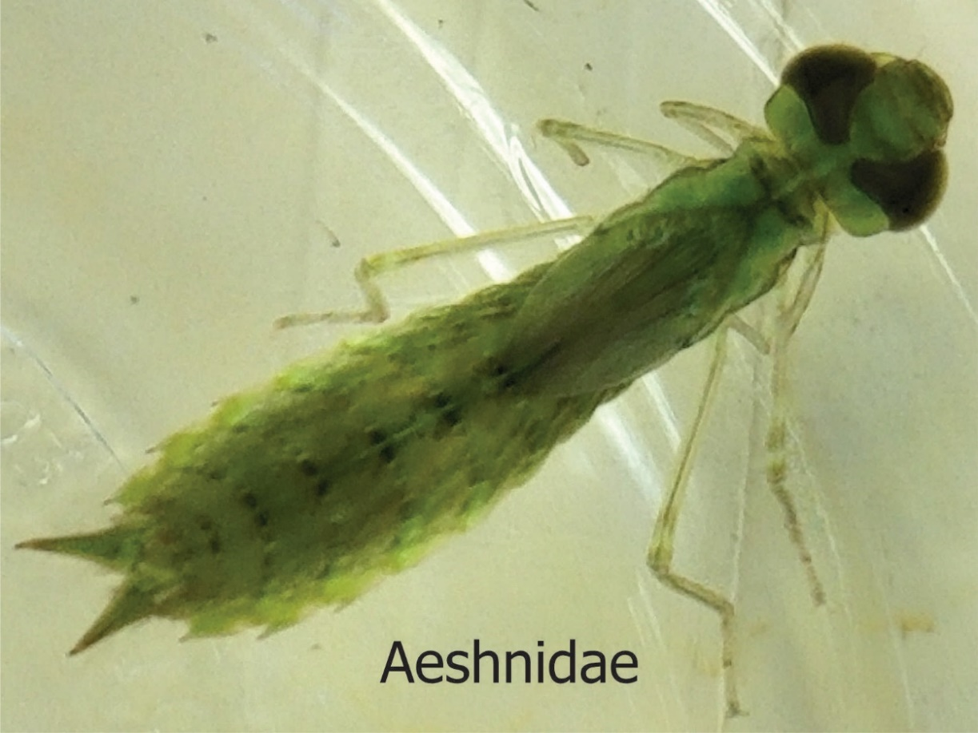
Dragonfly Naiad Biology
Naiads are voracious carnivores, feeding on other insect larvae, crustaceans, worms, snails, leeches, tadpoles and small fish.
Dragonfly naiads are commonly described in terms of one of four categories which represent their preferred microhabitats and activity levels: claspers (Family: Aeshnidae), sprawlers (Families: Macromiidae, Corduliidae, Libellulidae), hiders (Family:Cordulegastridae), and burrowers (Family:Gomphidae),

Slide 5
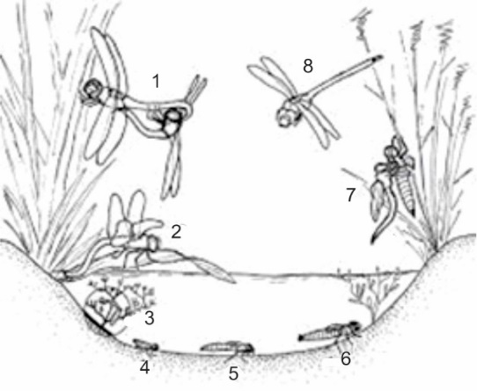
Dragonfly Life Cycle
Mating of adult dragonflies takes place in the “wheel” formation. The male clasps the female behind the head and the female brings her abdomen up to meet the male. This process may take a few minutes to several hours.
2-3. Female dragonflies lay eggs generally on surface vegetation. When the eggs hatch, resulting naiads generally move to underwater vegetation or to the bottom sediments.
4–6. Naiads generally molt 5–14 times until fully mature. Larval development typically takes 1–2 years, but ranges from 2–3 months to more than five years.
Development takes longer in cooler waters where food is scarcer, while in warm waters there may be a new generation every year.
Emergence: Naiads climb out of the water usually on plant stems and emerge from their exoskeleton as adults. This process may take several hours to a few days.
8. Adult dragonflies are fast flying aerial predators near and away from water. They typically live for about 1-8 weeks.

Slide 6
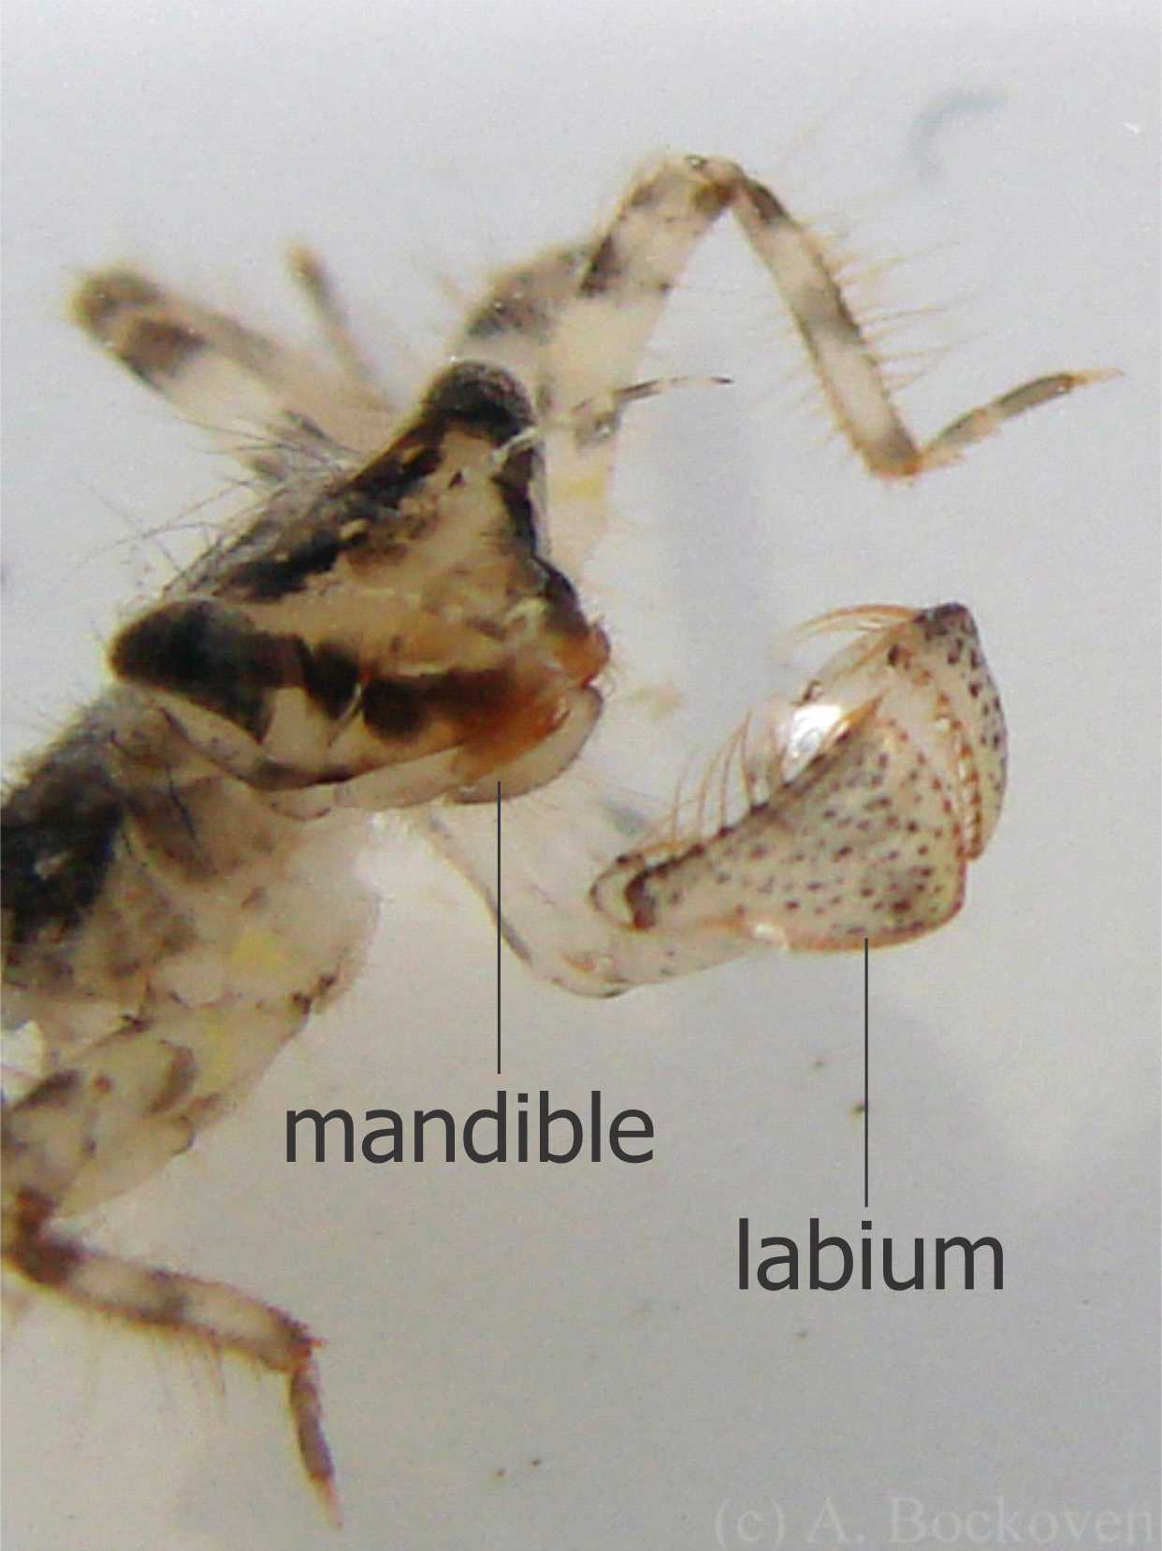
The naiads’ mouthparts are well adapted to their predatory lifestyle. They are composed of stout mandibles and maxillae for chewing solid food. The labium is modified into a hinged scoop that can be thrust forward rapidly to catch prey. The labium can be shot in the direction of prey almost the length of the naiad’s body. The end of the labium has hooks on it that grasp the prey so it can be dragged back to the mouth where it is chewed by the mandibles

Slide 7
Naiads move rapidly through the water, jet-propelling their bodies by using their abdominal muscles to move water in through their mouth and expelling it out their anus. The naiads have gills inside their rectum so the flow of water across the gills also serves as a means of gas exchange.

Slide 8
Dragonfly Naiads in Research
Mercury Project: https://geonarrative.usgs.gov/dmp/
The Dragonfly Mercury Project (DMP) is a citizen science project sponsored and coordinated by the U.S. Geological Survey and the National Park Service. It is focused on assessing mercury contamination in freshwater ecosystems across the United States, using dragonfly naiads as bioindicators.
The DMP is now the nation's largest assessment of mercury contamination and environmental risk. Since 2009, over 8,500 volunteers have helped collect dragonfly larvae at more than 190 national parks and other protected areas across the U.S. for mercury analysis
The study indicates that mercury concentrations are highest in larvae from rivers and streams in the U.S. compared to still waters.

Slide 9
Evolutionary Biology
Recent Publication :
L.L. Iversen, j. Garia Mmarques, A. Grigoropoulou, M. O’Connor, s. Domisch, L. Lanacaster. 2025. Complex Life Cycles Shape the Functional Biogeography of European Dragonflies. Global Ecology and Biogeography (GEB) https://doi.org/10.1111/geb.70056
analysis of 87 European dragonfly species highlights that the temperatures and seasonal patterns experienced by dragonfly naiads underwater have a greater impact on adult trait variety than the climate the adult insects encounter in the air. This study challenges traditional conservation approaches that primarily focus on the adult stage of the insect.

Slide 10
Lab Instructions and Modifications
Protocol Change
Effect of Space: Sample every 15 min for 1 hour; not every 30 min for 1 hour as written
Technique: Counting prey (daphnia and amphipods)
Using a plastic pipette, remove the uneaten daphnia from the bowl and place them in drops of water on a large petri dish. Remember to check the naiads body for any daphnia that may have become attached to their body.
Participant Groups
Effect of Space
2 groups use daphnia
3 groups use amphipods
Prey Preference
All 5 groups use daphnia + amphipods
Effect of light
1 group light daphnia
2 groups no light daphnia
1 group light amphipods
1 group no light amphipods

