Slide 1
Biome Name
Student names
Note: This template is a basic outline for the assignment. Remove the images and text that are provided and replace with your own creative ideas and images.

Slide 2
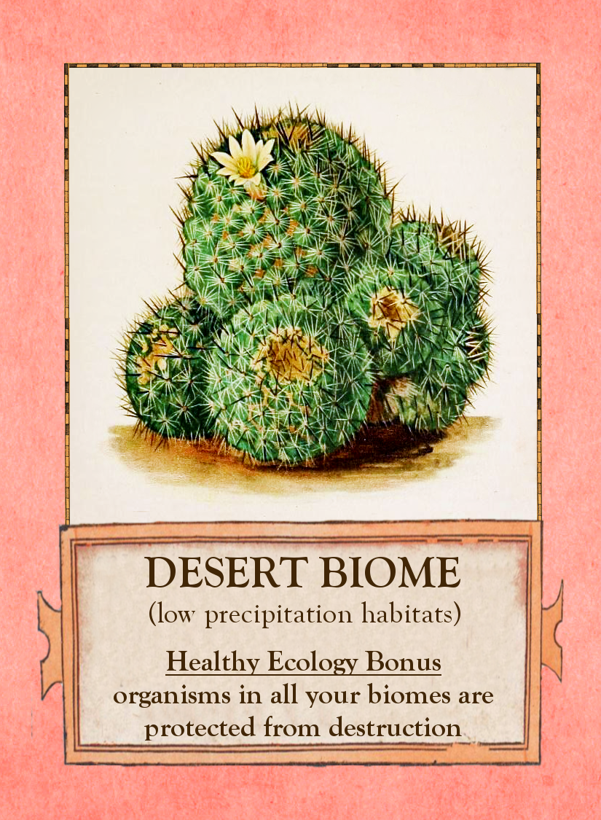
Biome Card
1 image representative of the biome
Brief description of the biome (1-2 sentences).
Optional: Healthy Ecology Bonus

Slide 3
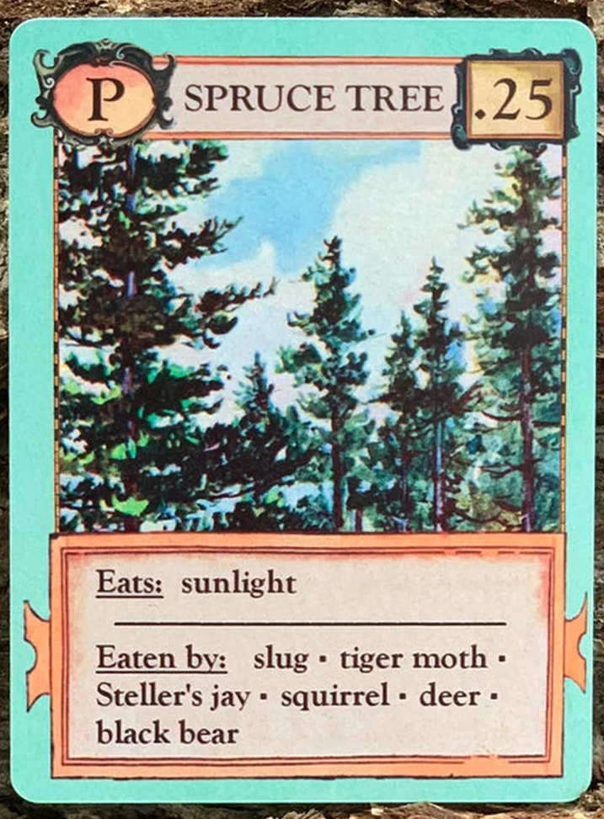
Producer Card
Image of the organism
Eats:
Eaten by:

Slide 4
Producer Card
Image of the organism
Eats:
Eaten by:

Slide 5
C1 Card
Image of the organism
Eats:
Eaten by:

Slide 6
C1 Card
Image of the organism
Eats:
Eaten by:

Slide 7
C2-C3 Card
Image of the organism
Eats:
Eaten by:

Slide 8
C2-C3 Card
Image of the organism
Eats:
Eaten by:

Slide 9
C4 Card
Image of the organism
Eats:
Eaten by:

Slide 10
SD Card
Image of the organism
Eats:
Eaten by:

Slide 11
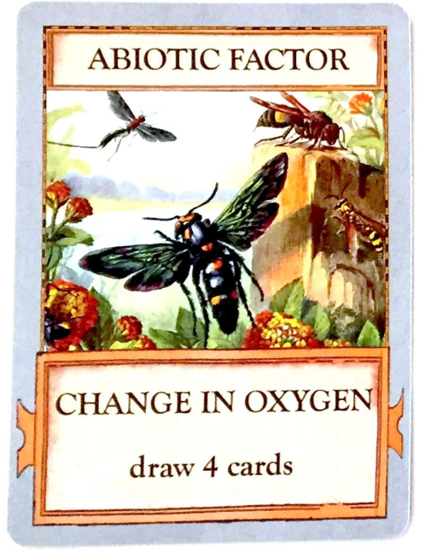
Factor Card
Identification as either an abiotic or biotic factor
Representative image
The factor
The impact of the factor

Slide 12
References

