Slide 1
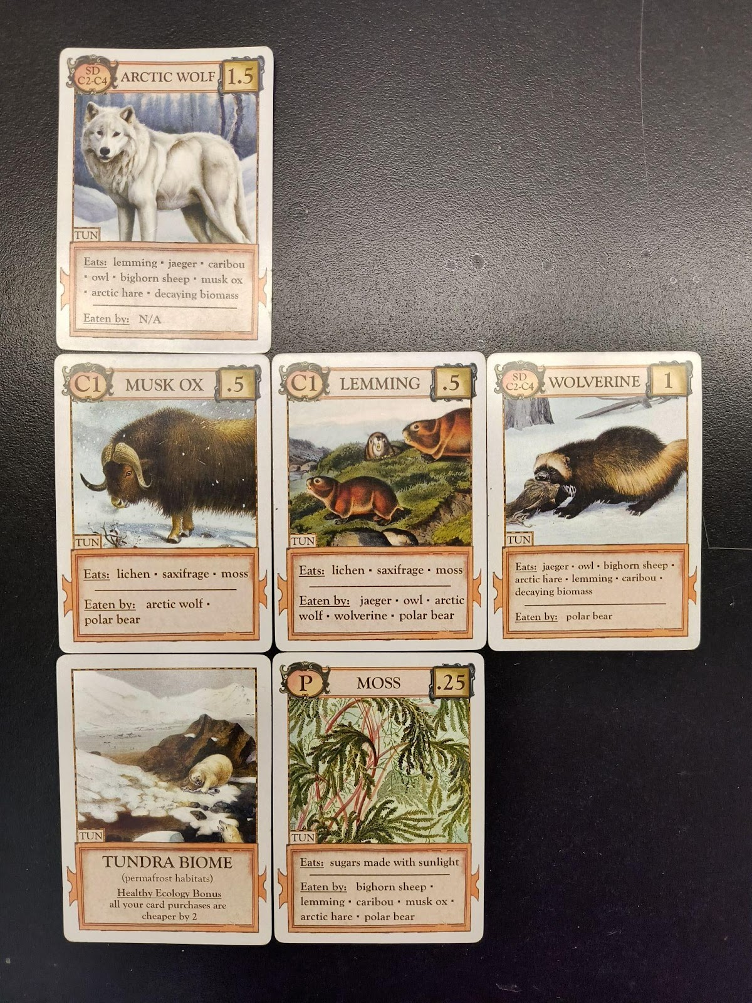
Ecologies: A Versatile (and Fun) Strategy Game for Teaching Ecological Concepts
Sanjiva Gunasekara and Amber Reece
Department of Biology – California State University, Fresno

Slide 2
Trophic Cascades
Direct effect: immediate impact of one organism on another
  Ex: a predator preying on a prey species
    Noted in a food web by a solid line connecting two species
Indirect effect: influence of one organism is mediated through a third organism; creates a chain of effects
  Ex: a predator reducing the population of herbivores which in turn allows a plant species to thrive due to decreased herbivory
    Noted in a food web by a dotted line connecting two species

Slide 3
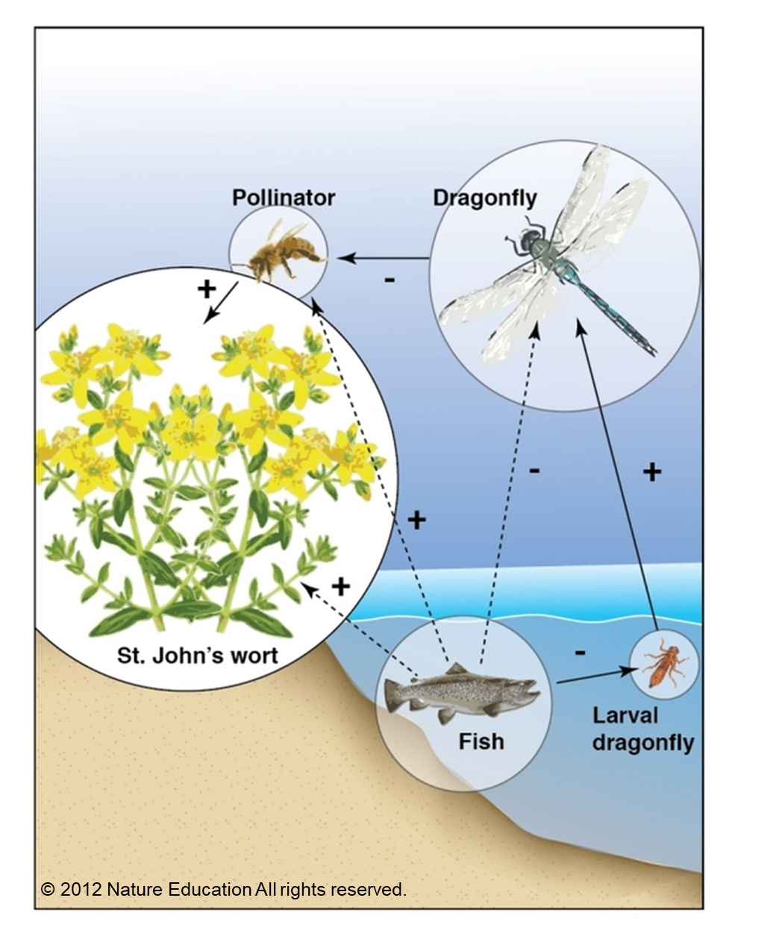
Direct & Indirect Effects
An interaction food web shows that fish have indirect effects on the populations of several species in and around ponds.
The solid arrows represent direct effects, and the dashed arrows indirect effects; the nature of the effect is indicated by + or -.
Fish have indirect effects, through a trophic cascade, on several terrestrial species: dragonfly adults (-), pollinators (+), and plants (+)
Notes:
Fish reduce (and/or decimate) dragonfly populations when they start their lives in the water as larvae. Those dragonflies that can escape the fish grow up to live outside the water environment, where one of their major prey are bees.

Slide 4
History of Wolves in Yellowstone
1872: creation of the Yellowstone National Park did not provide protection for any wildlife in the park
1926: government predator removal programs led to the extirpation of gray wolves
1974: gray wolf is listed as an endangered species
1991: Congress allocates money for a wolf recovery program
1995/ 96: 31 wolves are relocated from western Canada to YNP
1997: 10 wolves from nw Montana relocated to YNP
2017: gray wolves are no longer listed as an endangered species
Notes:
How did dwindling wolf populations impact the Yellowstone ecosystem?

Slide 5
Brainstorm (and draw)
With your group and using the provided poster paper/markers, draw a food web depicting the relationships between the following species in the Yellowstone ecosystem. Don’t worry about depicting direct and indirect effects at this point.
Create a food web depicting the relationships between the following species in the Yellowstone ecosystem.
Gray wolves
Elk
Grizzly bears
Willow trees
Grasses
Bison
Berry shrubs

Slide 6
Wolves of Yellowstone video

Slide 7
Revisit
Rework your food web based on the information in the video. Incorporate the following animals into the food web as well. Additionally, incorporate direct and indirect effects into your food web.
Beavers
Coyotes
Fish
Song birds
Small mammals such rodents and rabbits
Scavengers such as ravens and vultures
Notes:
https://earthjustice.org/feature/infographic-wolves-keep-yellowstone-in-the-balance
https://www.pinterest.com/pin/167266573637101350/

Slide 8
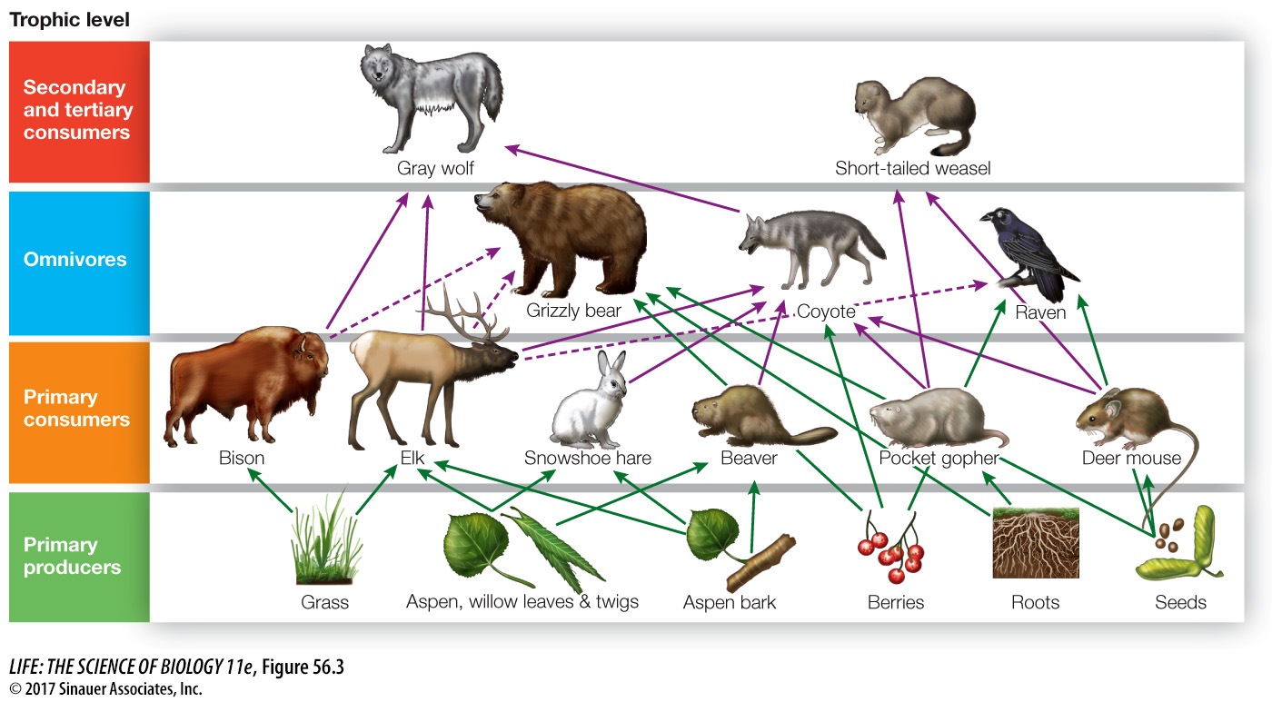
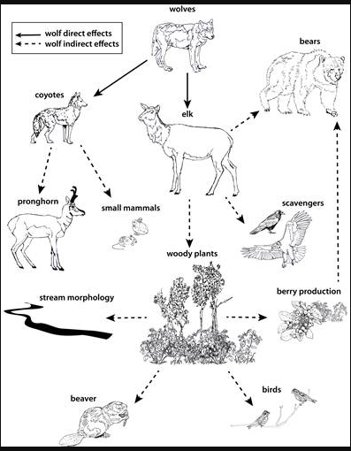
https://cases.open.ubc.ca/w17t2cons200-18/
Notes:
Here is an example of a food web with trophic levels.

Slide 9
Regulation within Ecosystems
Top down control: process where organisms at higher trophic levels regulate the populations of organisms at lower trophic levels
  Dominant factor at higher trophic levels
Bottom up control: occurs when physical conditions and nutrients control ecosystems
  Dominant factor at lower trophic levels
Can occur simultaneously or be based on seasonal factors
Notes:
Top down: limitation by enemies
Bottom up: limitation by resources

Slide 10
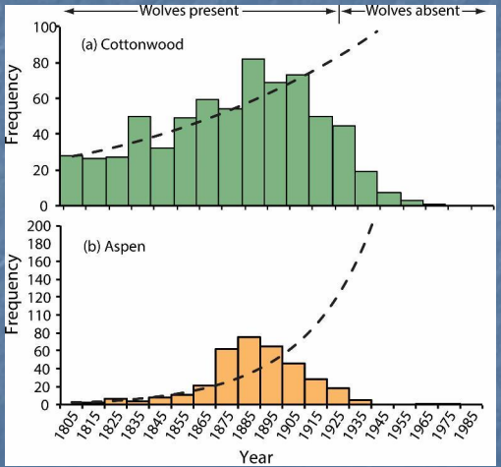
Top Down Control
Apex predators have impacts throughout a food web through direct and indirect effects

Slide 11
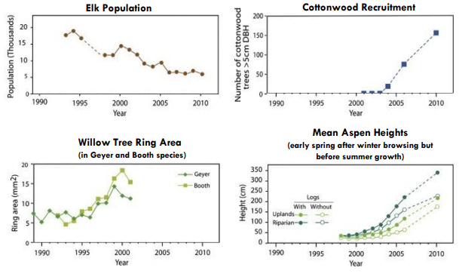
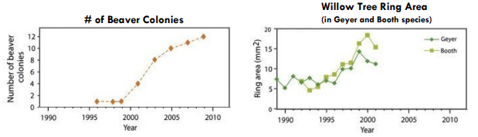
Top Down Control
Apex predators have impacts throughout a food web through direct and indirect effects
Notes:
Data quantifying the impact of introducing gray wolves into Yellowstone.

Slide 12
Ecologies Game (How to Play video)

Slide 13
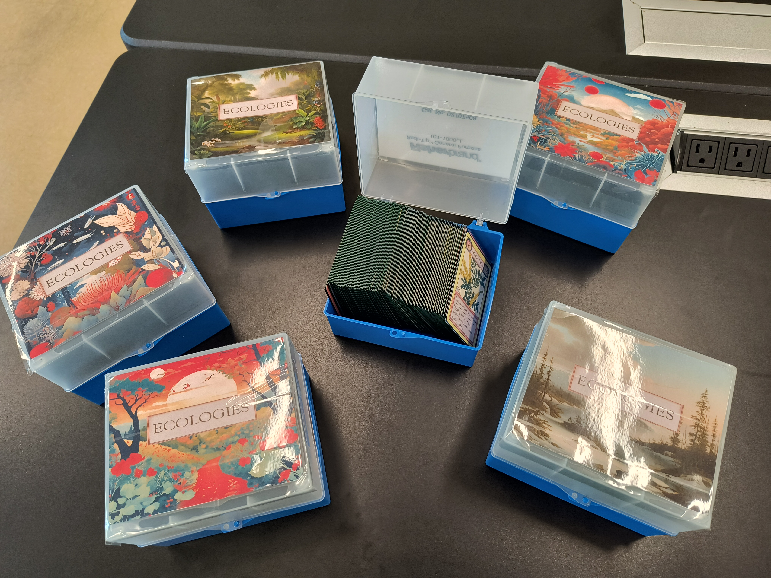
Ecologies Game
Form groups of 4 or 5
Play two rounds of the game with your group:
  Round 1: Remove all factor cards and shuffle→1st player to 10 points wins
  Round 2: Add factor cards and shuffle→1st player to 10 points wins

Slide 14
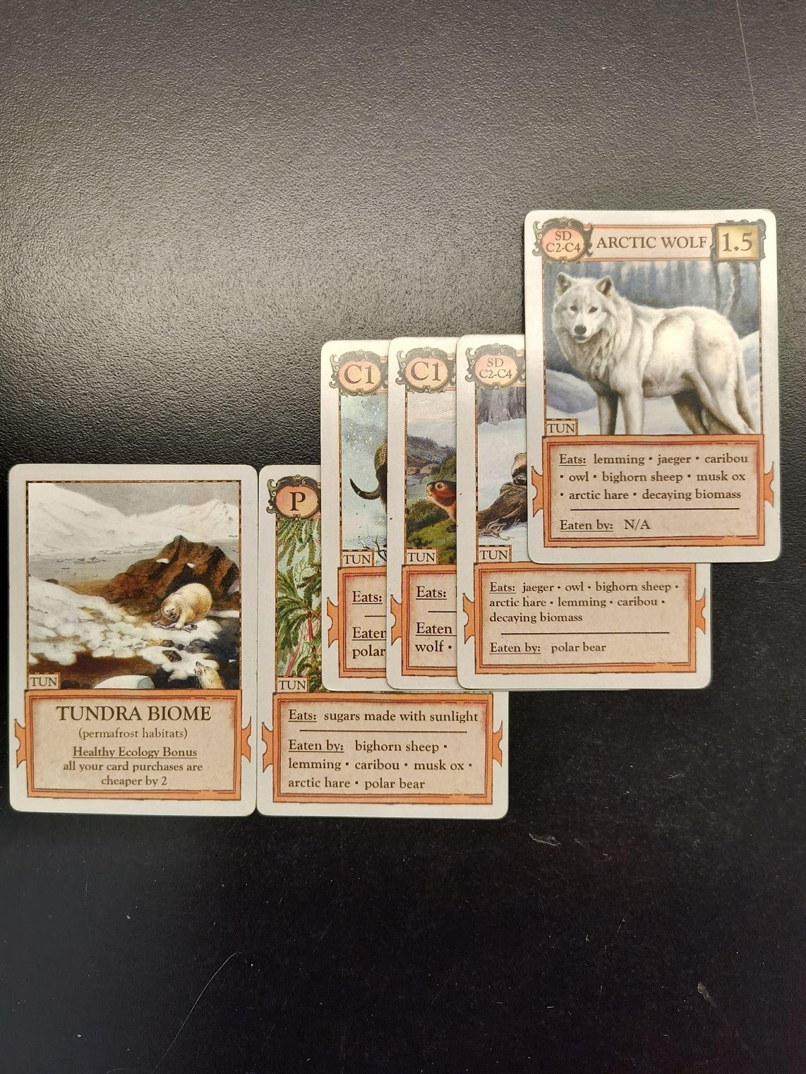
Ecologies Quick Start Guide
Playing a Turn
          REQUIRED: draw 2 cards from the deck
          OPTIONAL: trade cards with other players
          OPTIONAL: play up to 3 cards
          OPTIONAL: purchase cards from deck at 4:1 rate
Building Biomes
          First: Biome card
          Second: Producer card that matches biome
          Then: C1 or SD card
          Then: C2 → C3
          Cards can be rearranged during your turn
Winning the Game = 10 points
          Use scorecard to keep track of points as you play cards
Notes:
Default rules have players play up to 2 cards (not 3), and require 12 points to win.

Slide 15
Biome Creation Assignment
As a group, create your own biome with all the necessary levels + 1 factor card
Create in Google Slides, add pictures and content. Minimum of 11 slides in your group’s presentation.
  Introduction slide with group information (student names)
  10 card slides
    Biome card
    Producers: 2
    C1: 2
    C2-C3: 2
    C4: 1
    SD: 1
  Factor (abiotic or biotic) card
  References slide
Download the presentation as .pptx or .pdf and submit the assignment on Canvas.

